Slide 1




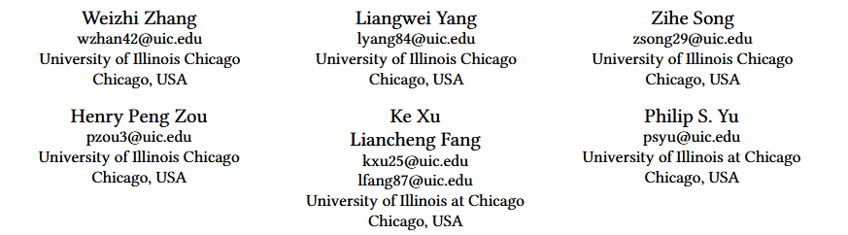





ATAI
Advanced Technique of Artificial Intelligence
ATAI
ChongqingUniversity _{AdvancedTechniqueof}
of Technology Artificial Intelligence
Chongqing University of
Technology
Chongqing University ^{ATAI}
_{of Technology} Advanced Techniqueof
Artificial Intelligence
Chongqing University of Technology
Chongqing University of Technology
Do We Really Need Graph Convolution During Training? Light Post-Training Graph-ODE for Efficient Recommendation
Code：https://github.com/DavidZWZ/LightGODE
—— CIKM ’24
Reported by Jingbo Liu
1

Slide 2
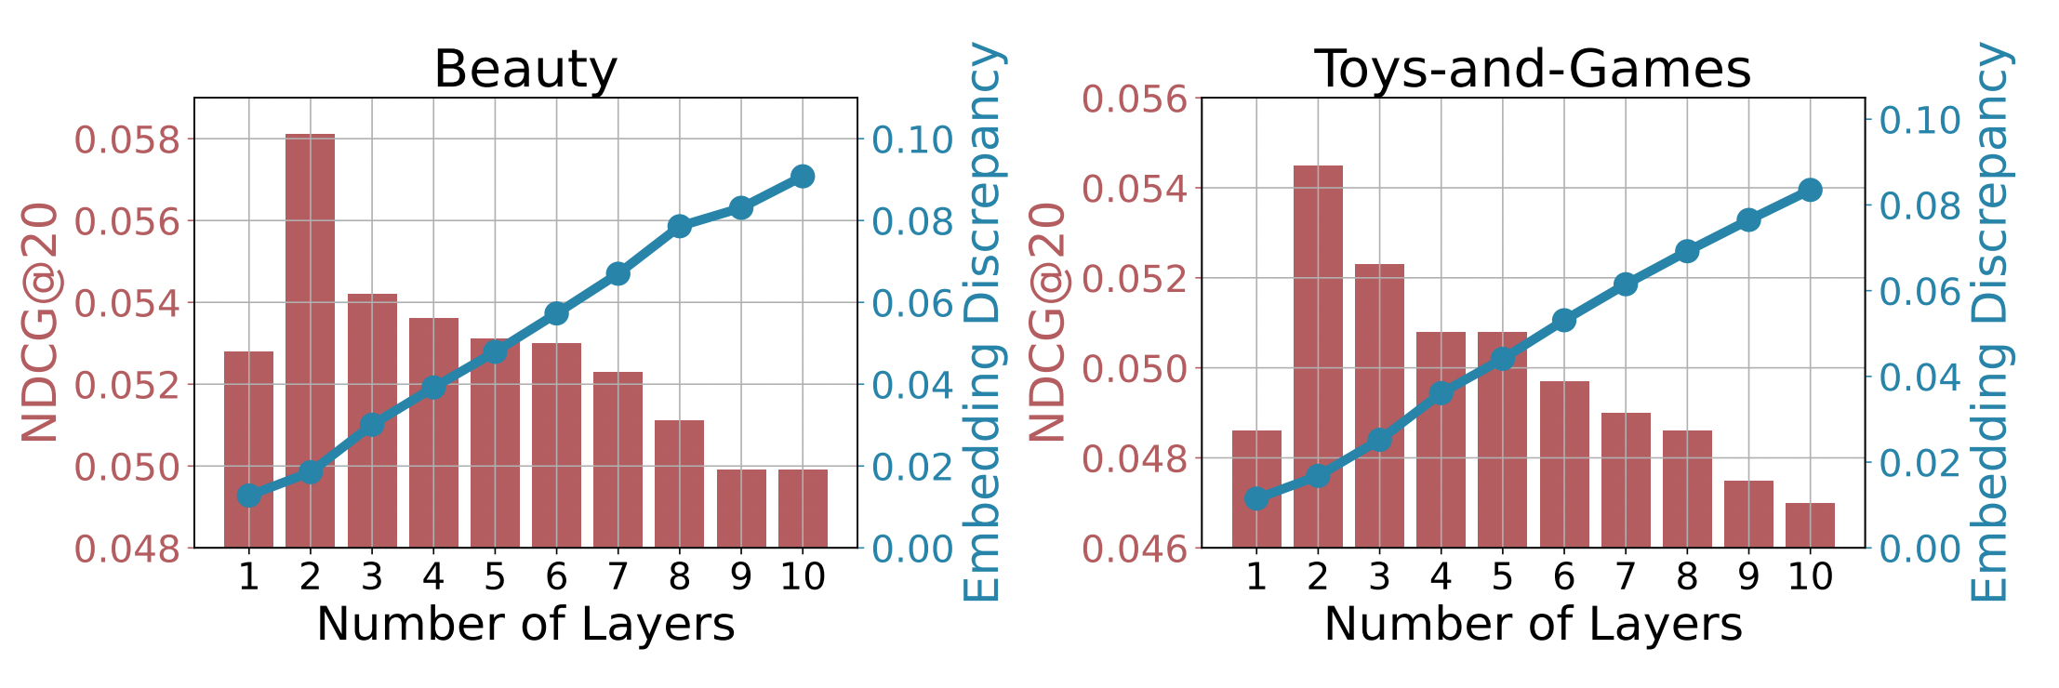
ATAI
Advanced Technique of Artificial Intelligence
ATAI
ChongqingUniversity _{AdvancedTechniqueof}
of Technology Artificial Intelligence
Chongqing University of
Technology
Chongqing University ^{ATAI}
_{of Technology} Advanced Techniqueof
Artificial Intelligence
Chongqing University of Technology
Chongqing University of Technology
motive
This necessitates a more nuanced graph convolution approach that delicately constructs layers to maintain a trade-off between high-order structure information and the embedding discrepancy issue.

Slide 3
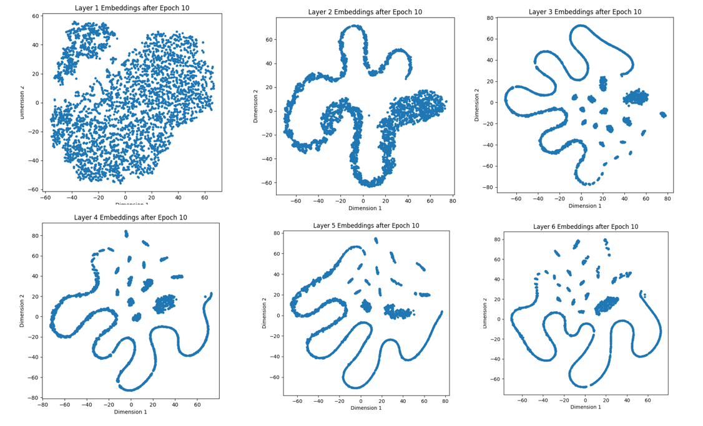
ATAI
Advanced Technique of Artificial Intelligence
ATAI
ChongqingUniversity _{AdvancedTechniqueof}
of Technology Artificial Intelligence
Chongqing University of
Technology
Chongqing University ^{ATAI}
_{of Technology} Advanced Techniqueof
Artificial Intelligence
Chongqing University of Technology
Chongqing University of Technology
over-smoothing

Slide 4
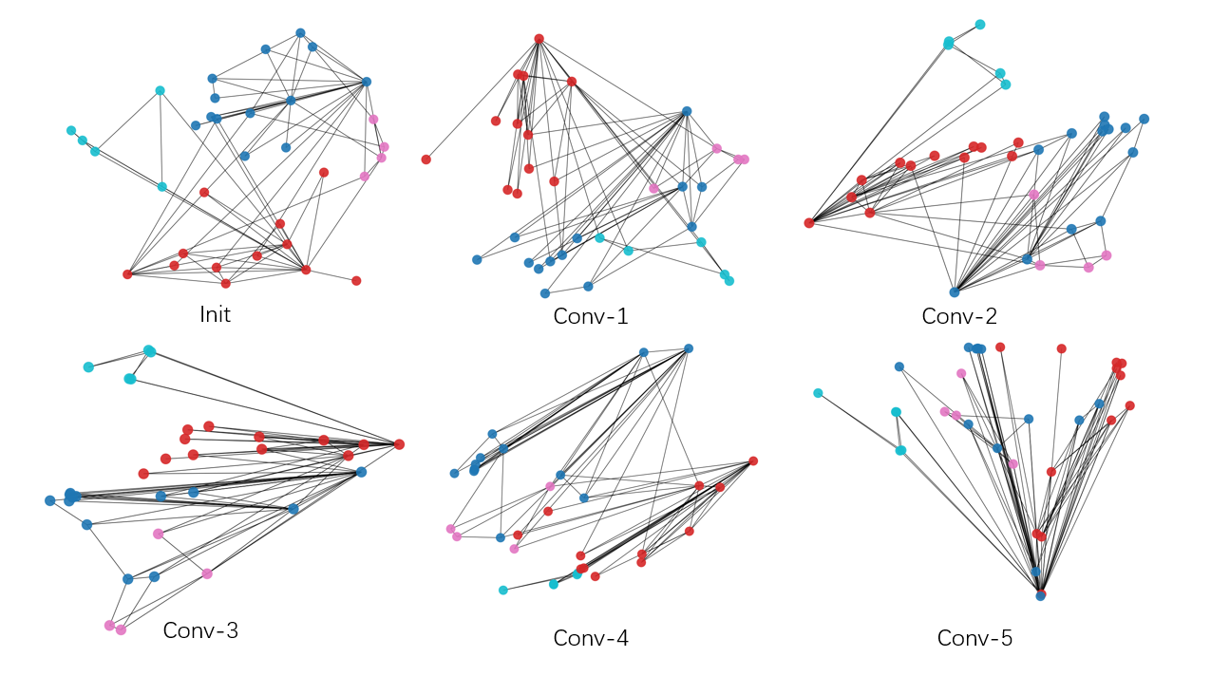
ATAI
Advanced Technique of Artificial Intelligence
ATAI
ChongqingUniversity _{AdvancedTechniqueof}
of Technology Artificial Intelligence
Chongqing University of
Technology
Chongqing University ^{ATAI}
_{of Technology} Advanced Techniqueof
Artificial Intelligence
Chongqing University of Technology
Chongqing University of Technology
over-smoothing

Slide 5
ATAI
Advanced Technique of Artificial Intelligence
ATAI
ChongqingUniversity _{AdvancedTechniqueof}
of Technology Artificial Intelligence
Chongqing University of
Technology
Chongqing University ^{ATAI}
_{of Technology} Advanced Techniqueof
Artificial Intelligence
Chongqing University of Technology
Chongqing University of Technology
motive
This necessitates a more nuanced graph convolution approach that delicately constructs layers to maintain a trade-off between high-order structure information and the embedding discrepancy issue.

Slide 6
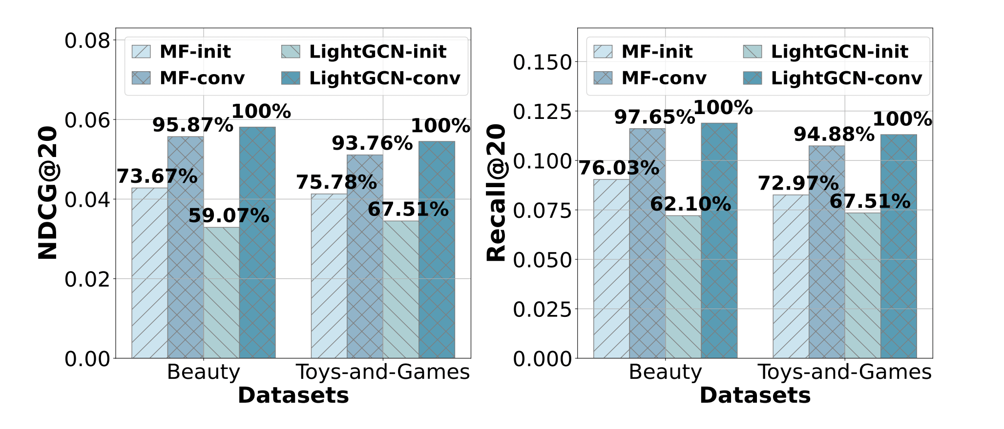
ATAI
Advanced Technique of Artificial Intelligence
ATAI
ChongqingUniversity _{AdvancedTechniqueof}
of Technology Artificial Intelligence
Chongqing University of
Technology
Chongqing University ^{ATAI}
_{of Technology} Advanced Techniqueof
Artificial Intelligence
Chongqing University of Technology
Chongqing University of Technology
motive
Furthermore, these results underscore that the improved performance of graph-based RecSys primarily arises from the graph convolution after training, which prompts a thorough reconsideration of the necessity of the graph convolution during the training phase.

Slide 7
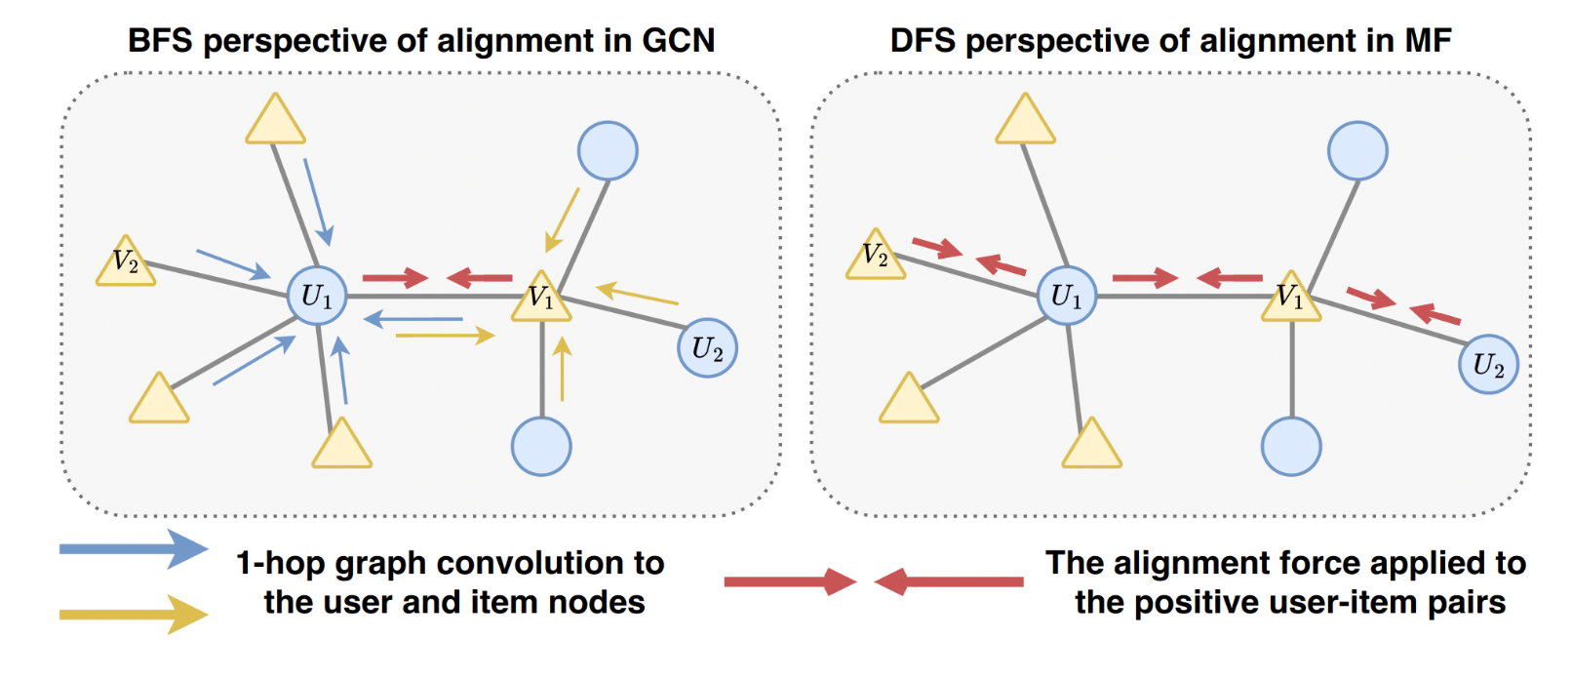
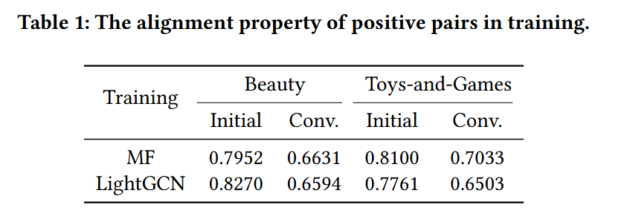
ATAI
Advanced Technique of Artificial Intelligence
ATAI
ChongqingUniversity _{AdvancedTechniqueof}
of Technology Artificial Intelligence
Chongqing University of
Technology
Chongqing University ^{ATAI}
_{of Technology} Advanced Techniqueof
Artificial Intelligence
Chongqing University of Technology
Chongqing University of Technology
motive

Slide 8
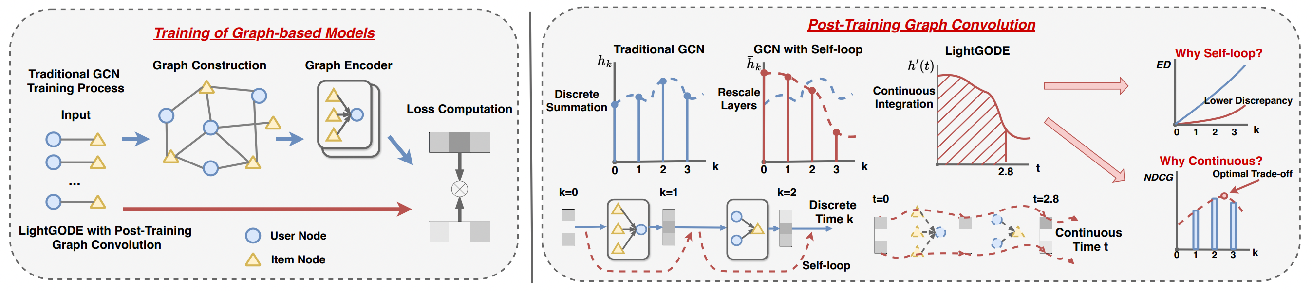
ATAI
Advanced Technique of Artificial Intelligence
ATAI
ChongqingUniversity _{AdvancedTechniqueof}
of Technology Artificial Intelligence
Chongqing University of
Technology
Chongqing University ^{ATAI}
_{of Technology} Advanced Techniqueof
Artificial Intelligence
Chongqing University of Technology
Chongqing University of Technology
Framework

Slide 9
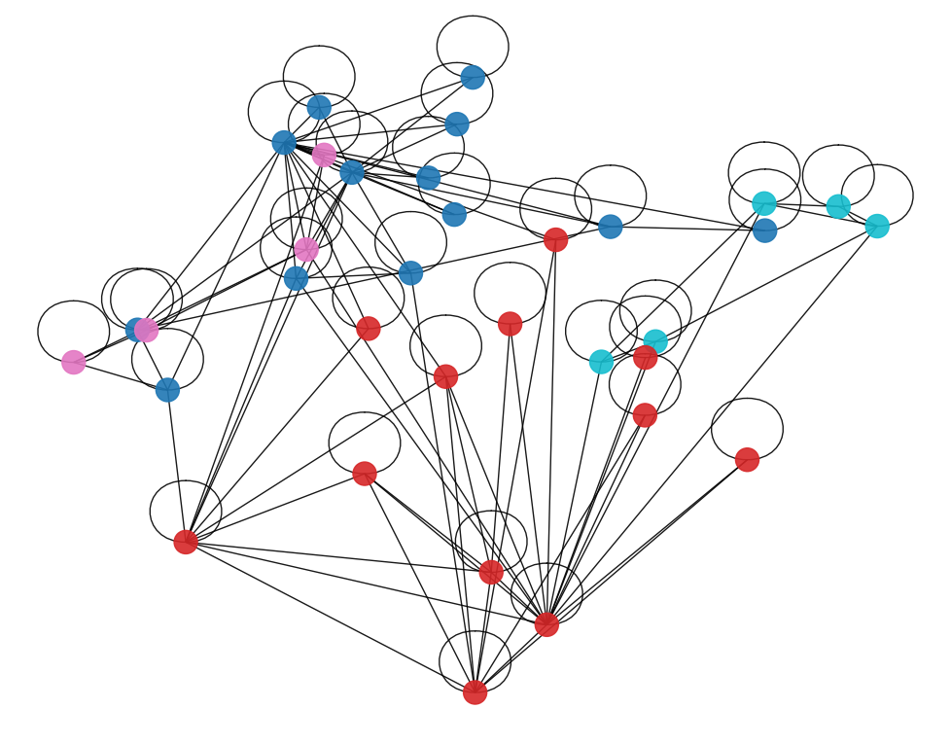
ATAI
Advanced Technique of Artificial Intelligence
ATAI
ChongqingUniversity _{AdvancedTechniqueof}
of Technology Artificial Intelligence
Chongqing University of
Technology
Chongqing University ^{ATAI}
_{of Technology} Advanced Techniqueof
Artificial Intelligence
Chongqing University of Technology
Chongqing University of Technology
Self-Loop

Slide 10
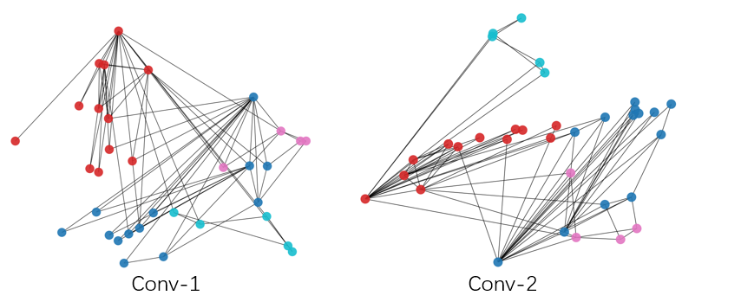
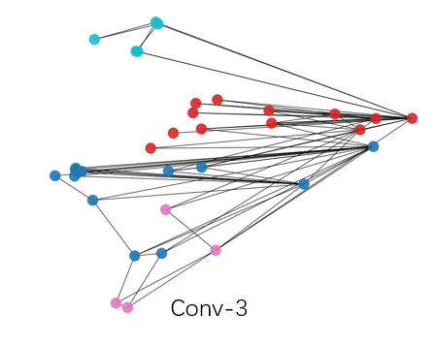
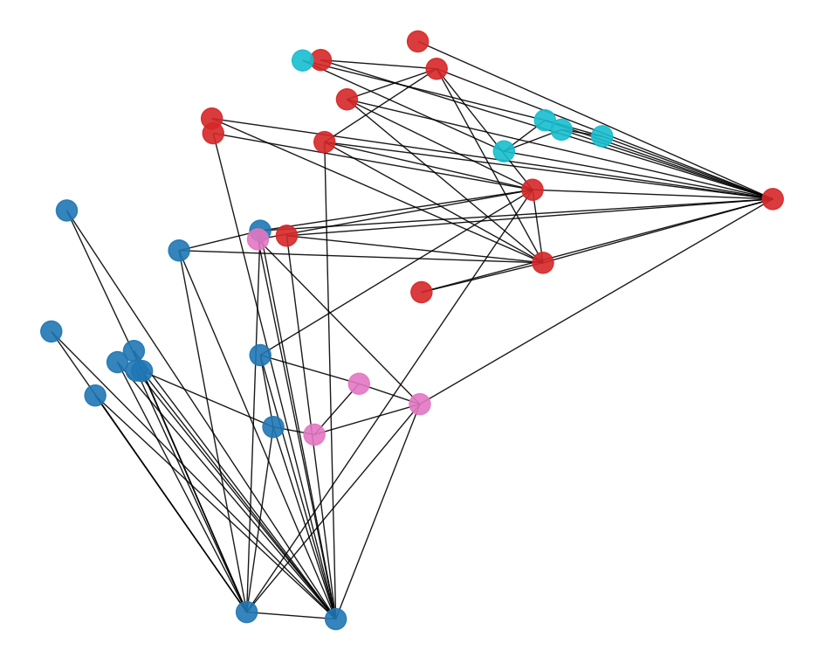
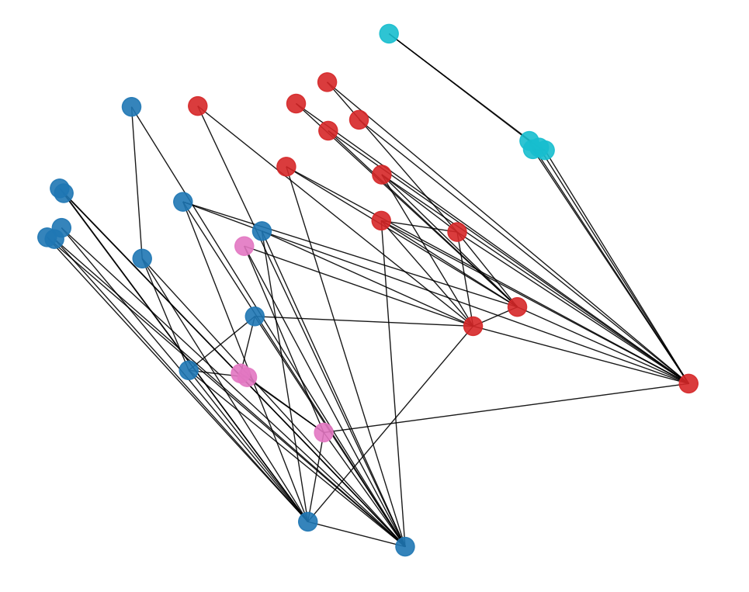
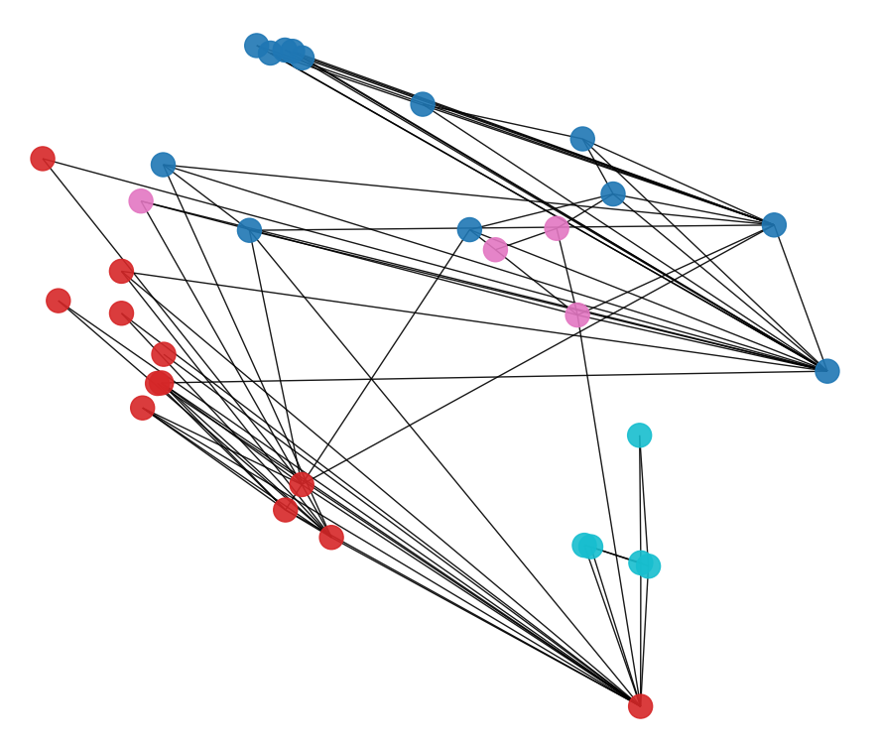
ATAI
Advanced Technique of Artificial Intelligence
ATAI
ChongqingUniversity _{AdvancedTechniqueof}
of Technology Artificial Intelligence
Chongqing University of
Technology
Chongqing University ^{ATAI}
_{of Technology} Advanced Techniqueof
Artificial Intelligence
Chongqing University of Technology
Chongqing University of Technology
Conv_SL-1
Conv_SL-2
Conv_SL-3

Slide 11
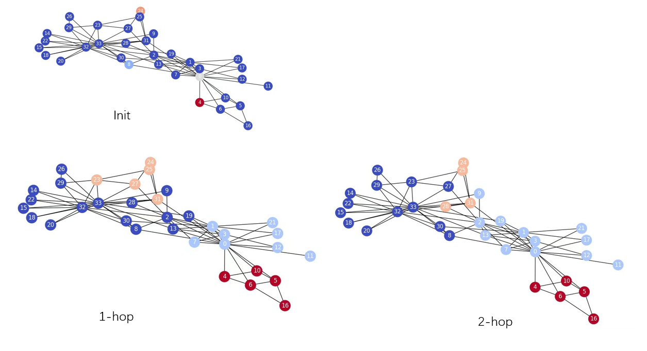
ATAI
Advanced Technique of Artificial Intelligence
ATAI
ChongqingUniversity _{AdvancedTechniqueof}
of Technology Artificial Intelligence
Chongqing University of
Technology
Chongqing University ^{ATAI}
_{of Technology} Advanced Techniqueof
Artificial Intelligence
Chongqing University of Technology
Chongqing University of Technology

Slide 12




ATAI
Advanced Technique of Artificial Intelligence
ATAI
ChongqingUniversity _{AdvancedTechniqueof}
of Technology Artificial Intelligence
Chongqing University of
Technology
Chongqing University ^{ATAI}
_{of Technology} Advanced Techniqueof
Artificial Intelligence
Chongqing University of Technology
Chongqing University of Technology
Method

Slide 13
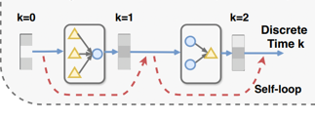
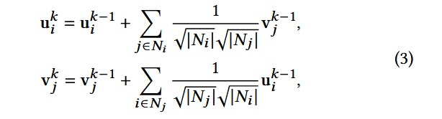
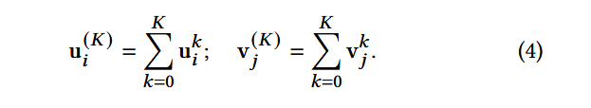
ATAI
Advanced Technique of Artificial Intelligence
ATAI
ChongqingUniversity _{AdvancedTechniqueof}
of Technology Artificial Intelligence
Chongqing University of
Technology
Chongqing University ^{ATAI}
_{of Technology} Advanced Techniqueof
Artificial Intelligence
Chongqing University of Technology
Chongqing University of Technology
Method

Slide 14
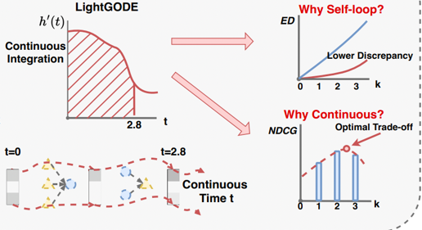





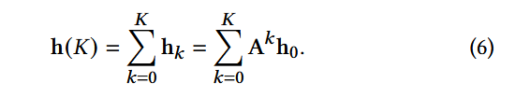



ATAI
Advanced Technique of Artificial Intelligence
ATAI
ChongqingUniversity _{AdvancedTechniqueof}
of Technology Artificial Intelligence
Chongqing University of
Technology
Chongqing University ^{ATAI}
_{of Technology} Advanced Techniqueof
Artificial Intelligence
Chongqing University of Technology
Chongqing University of Technology
Method

Slide 15





ATAI
Advanced Technique of Artificial Intelligence
ATAI
ChongqingUniversity _{AdvancedTechniqueof}
of Technology Artificial Intelligence
Chongqing University of
Technology
Chongqing University ^{ATAI}
_{of Technology} Advanced Techniqueof
Artificial Intelligence
Chongqing University of Technology
Chongqing University of Technology
Method

Slide 16

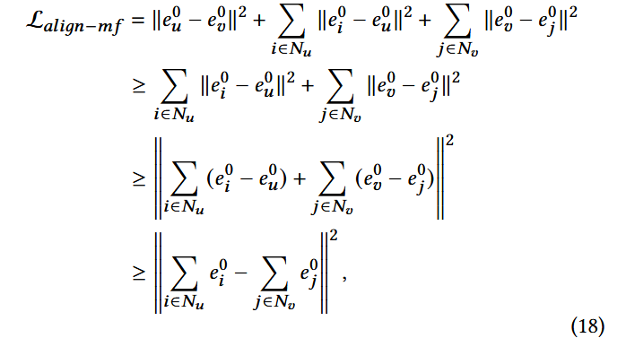
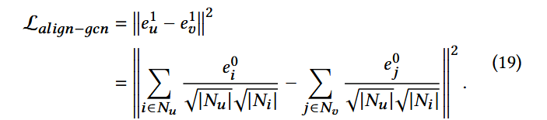
ATAI
Advanced Technique of Artificial Intelligence
ATAI
ChongqingUniversity _{AdvancedTechniqueof}
of Technology Artificial Intelligence
Chongqing University of
Technology
Chongqing University ^{ATAI}
_{of Technology} Advanced Techniqueof
Artificial Intelligence
Chongqing University of Technology
Chongqing University of Technology
Method

Slide 17
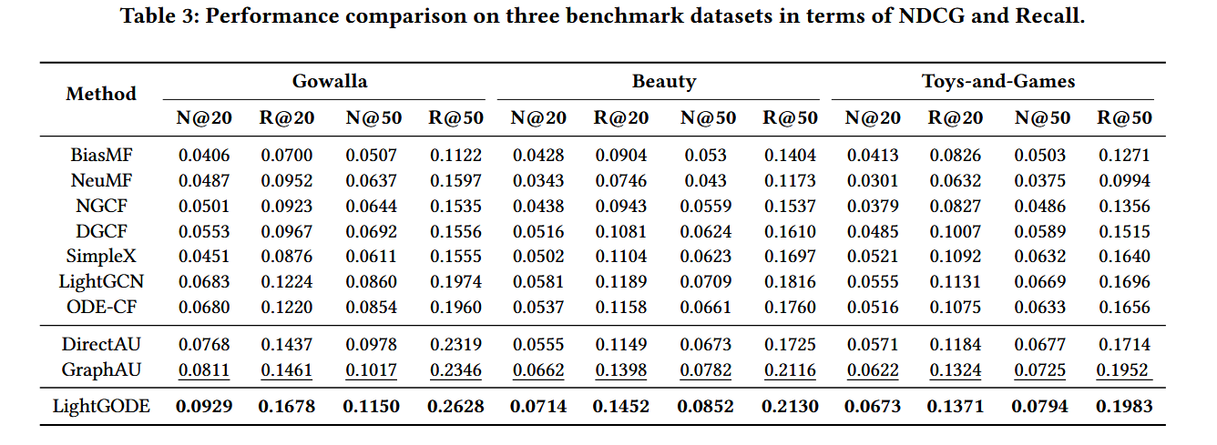
ATAI
Advanced Technique of Artificial Intelligence
ATAI
ChongqingUniversity _{AdvancedTechniqueof}
of Technology Artificial Intelligence
Chongqing University of
Technology
Chongqing University ^{ATAI}
_{of Technology} Advanced Techniqueof
Artificial Intelligence
Chongqing University of Technology
Chongqing University of Technology
Experiments

Slide 18
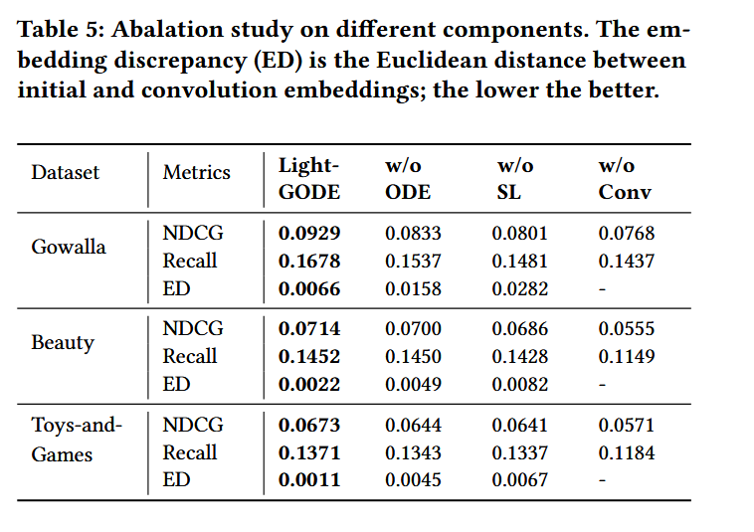
ATAI
Advanced Technique of Artificial Intelligence
ATAI
ChongqingUniversity _{AdvancedTechniqueof}
of Technology Artificial Intelligence
Chongqing University of
Technology
Chongqing University ^{ATAI}
_{of Technology} Advanced Techniqueof
Artificial Intelligence
Chongqing University of Technology
Chongqing University of Technology
Experiments

Slide 19
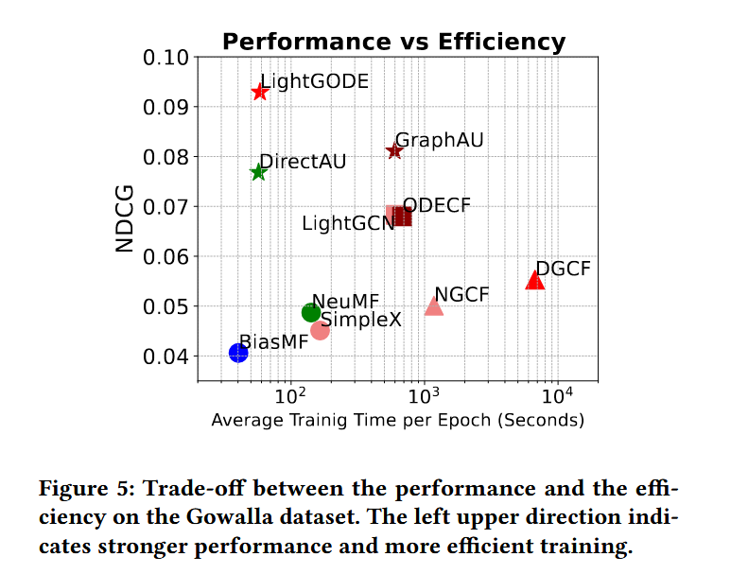
ATAI
Advanced Technique of Artificial Intelligence
ATAI
ChongqingUniversity _{AdvancedTechniqueof}
of Technology Artificial Intelligence
Chongqing University of
Technology
Chongqing University ^{ATAI}
_{of Technology} Advanced Techniqueof
Artificial Intelligence
Chongqing University of Technology
Chongqing University of Technology
Experiments

Slide 20
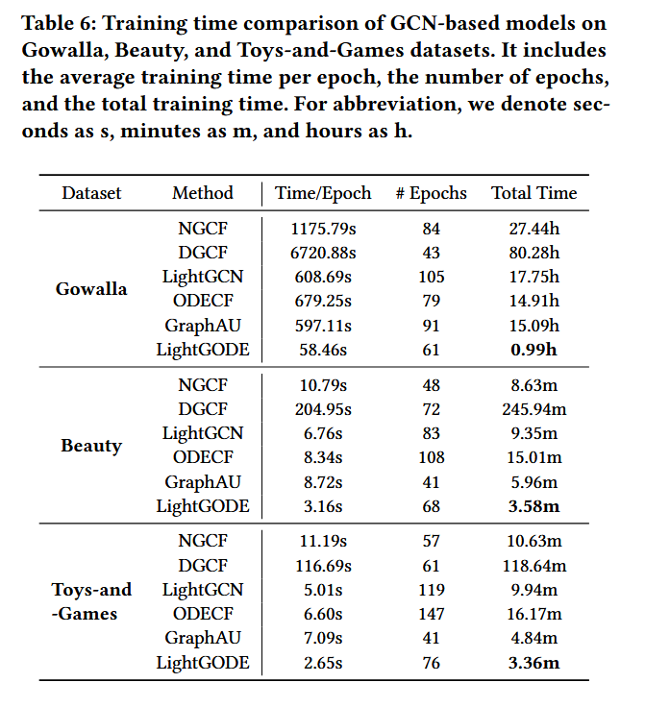
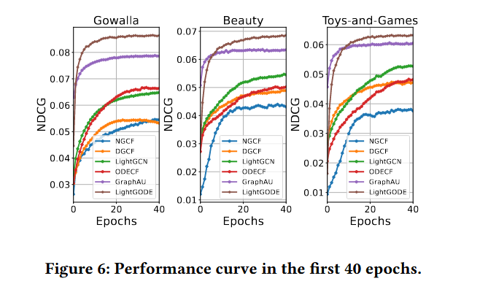
ATAI
Advanced Technique of Artificial Intelligence
ATAI
ChongqingUniversity _{AdvancedTechniqueof}
of Technology Artificial Intelligence
Chongqing University of
Technology
Chongqing University ^{ATAI}
_{of Technology} Advanced Techniqueof
Artificial Intelligence
Chongqing University of Technology
Chongqing University of Technology
Experiments

Slide 21
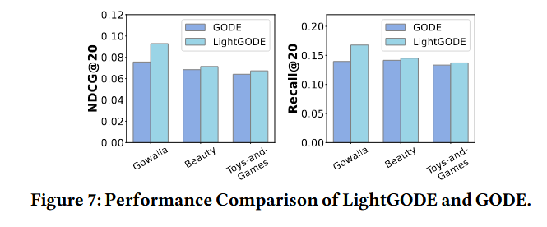
ATAI
Advanced Technique of Artificial Intelligence
ATAI
ChongqingUniversity _{AdvancedTechniqueof}
of Technology Artificial Intelligence
Chongqing University of
Technology
Chongqing University ^{ATAI}
_{of Technology} Advanced Techniqueof
Artificial Intelligence
Chongqing University of Technology
Chongqing University of Technology
Experiments

Slide 22
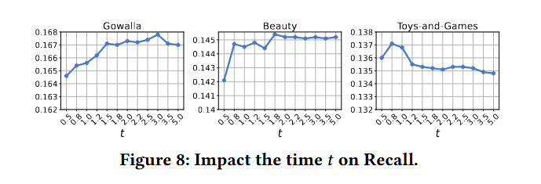
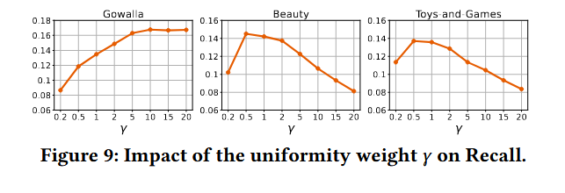
ATAI
Advanced Technique of Artificial Intelligence
ATAI
ChongqingUniversity _{AdvancedTechniqueof}
of Technology Artificial Intelligence
Chongqing University of
Technology
Chongqing University ^{ATAI}
_{of Technology} Advanced Techniqueof
Artificial Intelligence
Chongqing University of Technology
Chongqing University of Technology
Experiments

Slide 23


ATAI
Advanced Technique of Artificial Intelligence
ATAI
ChongqingUniversity _{AdvancedTechniqueof}
of Technology Artificial Intelligence
Chongqing University of
Technology
Chongqing University ^{ATAI}
_{of Technology} Advanced Techniqueof
Artificial Intelligence
Chongqing University of Technology
Chongqing University of Technology
Thanks!

